Slide 1
Natural Language Processing using TensorFlow 2.0
Usha Rengaraju

Slide 2
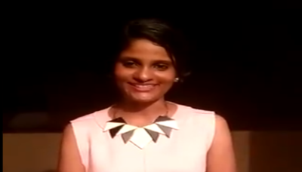
About Me
Kaggle Grandmaster
WiMLDS(Bangalore and Mysore)
TensorFlow User Group Organizer Mysuru
GDG Mysore Organizer Mysuru
Twitter : @URengaraju
Github : https://github.com/ushareng
Ambassador : Women TechMakers Mysuru , WiDS Mysuru(Women in Data Science)

Slide 3
Communities
WiMLDS Mysore :
https://www.meetup.com/Mysore-Women-in-Machine-Learning-and-Data-Science/
GDG Mysuru :
https://www.meetup.com/Google-Developers-group-Mysuru/
TensorFlow User Group Mysuru :
https://www.meetup.com/TFUG-Mysuru/

Slide 4
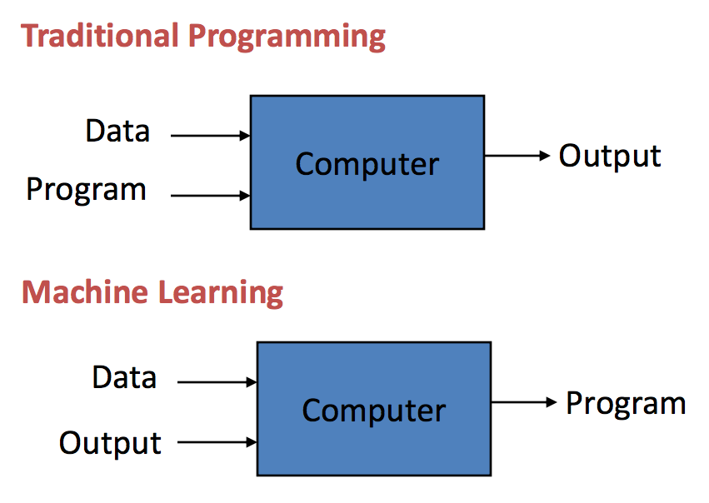
Machine Learning
“Machine Learning is the science of getting computers to act without being explicitly programmed “ - Andrew NG
Notes:
Pic Credit : https://machinelearningmastery.com/basic-concepts-in-machine-learning/

Slide 5
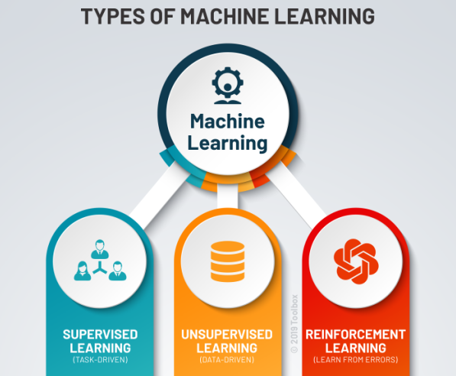
Types of Machine Learning
.
Notes:
Pic Credit : https://www.potentiaco.com/what-is-machine-learning-definition-types-applications-and-examples/

Slide 6
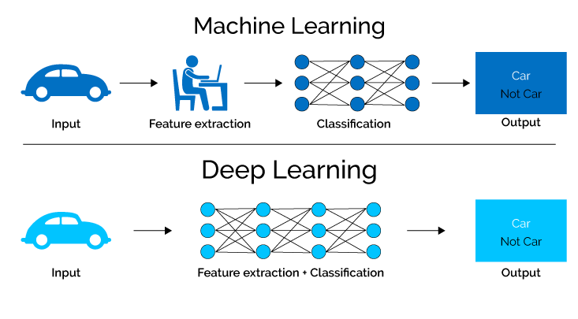
Deep Learning
Deep learning methods aim at learning feature hierarchies with features from higher levels of the hierarchy formed by the composition of lower level features. Automatically learning features at multiple levels of abstraction allow a system to learn complex functions mapping the input to the output directly from data, without depending completely on human-crafted features.-- “Learning Deep Architectures of AI”
Notes:
Pic Credit : https://semiengineering.com/deep-learning-spreads/
https://machinelearningmastery.com/what-is-deep-learning/

Slide 7
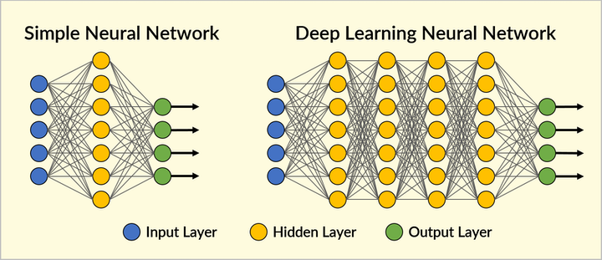
Neural Network Structure
..
Notes:
Pic Credit : https://www.securityinfowatch.com/video-surveillance/video-analytics/article/21069937/deep-learning-to-the-rescue

Slide 8
Important Concepts
Optimizer
Loss
Metrics
Activation Functions

Slide 9
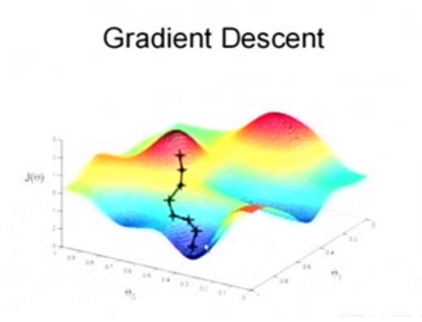
Optimizer
Optimizer minimizes Cost Function
Notes:
Pic Credit : https://www.quora.com/What-is-an-intuitive-explanation-of-the-AdaDelta-Deep-Learning-optimizer

Slide 10
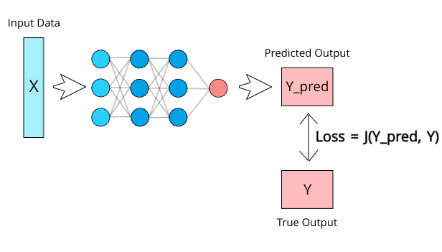
Loss
.
Notes:
Pic Credit : https://zhuanlan.zhihu.com/p/85540935

Slide 11
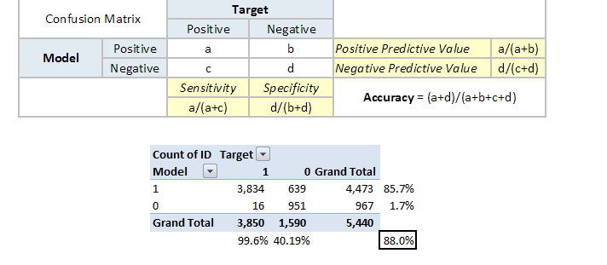
Metrics
.
Notes:
Pic Credit : https://www.analyticsvidhya.com/blog/2019/08/11-important-model-evaluation-error-metrics/

Slide 12
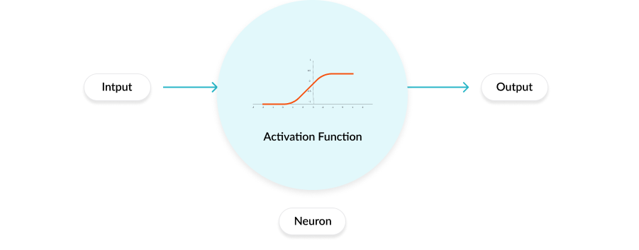
Activation Functions
Notes:
Pic Credit : https://missinglink.ai/guides/neural-network-concepts/7-types-neural-network-activation-functions-right/

Slide 13
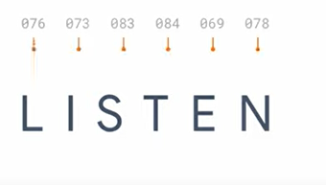
NLP Refresher
.

Slide 14
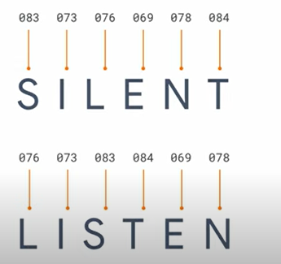
.

Slide 15
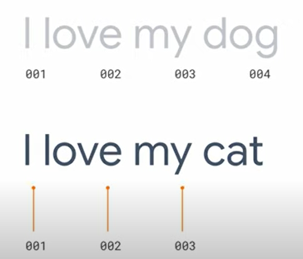
.

Slide 16
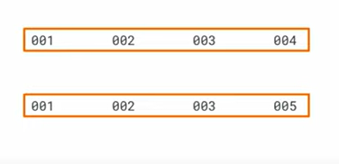
.

Slide 17
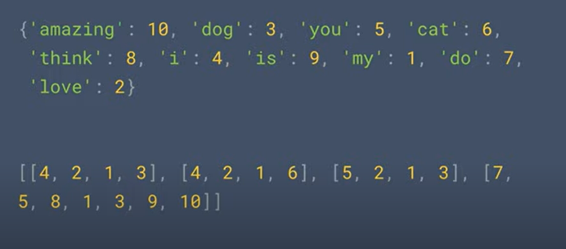
.

Slide 18
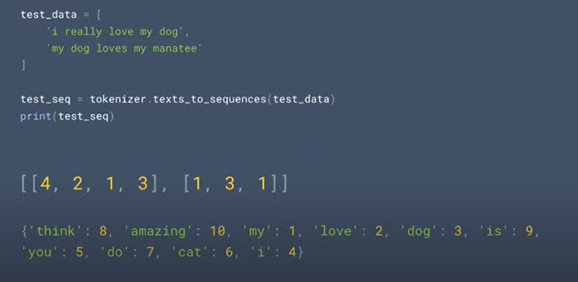
.

Slide 19
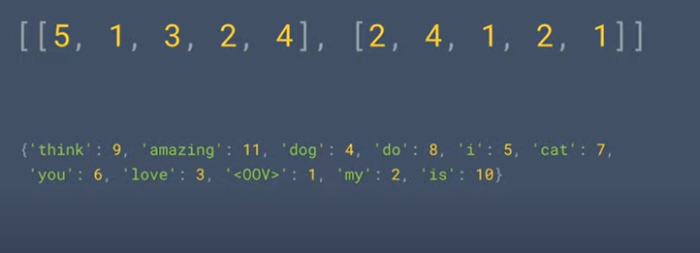
.

Slide 20
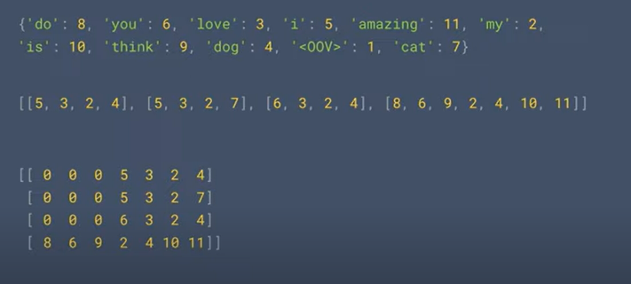
.

Slide 21
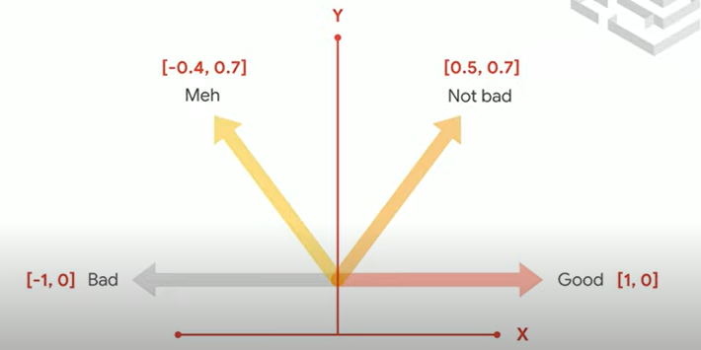
.

Slide 22
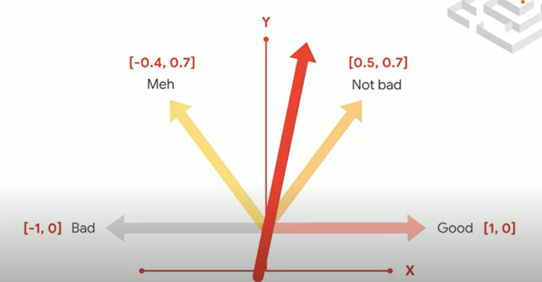
.

Slide 23
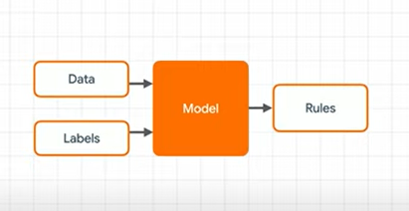
.

Slide 24
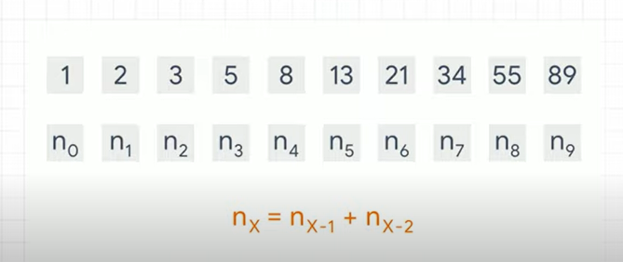
.

Slide 25
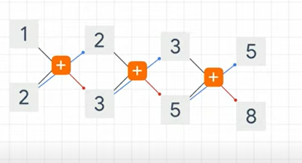
.

Slide 26
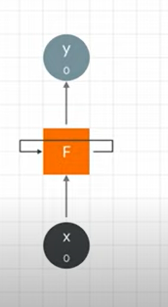
.

Slide 27
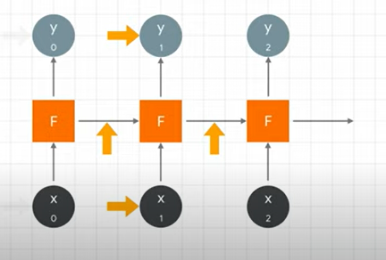
.

Slide 28
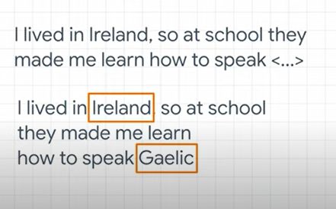
.

Slide 29
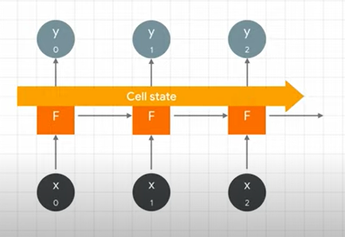
.

Slide 30
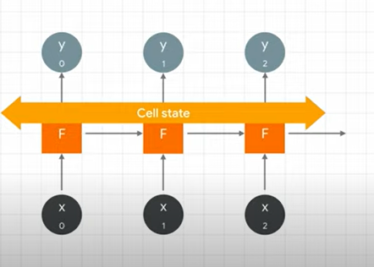
.

Slide 31
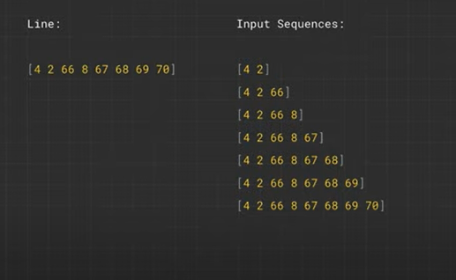
.

Slide 32
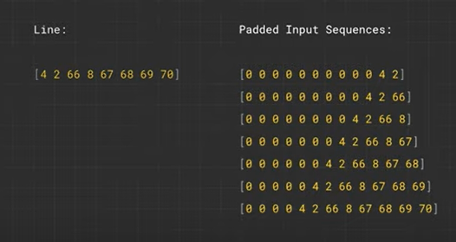
.

Slide 33
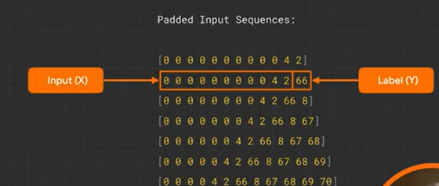
.

Slide 34
References
The notebooks and slide materials are taken from Official TensorFlow documentation and videos from official TensorFlow youtube channel

Slide 35
Thank You

